Slide 1

CAR SERVO
DEPARTMENT OF COMPUTER ENGINEERING AND APPLICATIONS Institute Of Engineering and Technology
GLA University
Mathura-281406,INDIA
2020

Slide 2
Content
Introduction to HTML
->HTML Links
->HTML Styles – CSS
-> class Attribute

Slide 3
HTML Links
HTML links are hyperlinks.
Hyperlinks are defined with the HTML <a> tag:
<a href="url">link text</a>
Use the target attribute to define where to open the linked document
Use the <img> element (inside <a>) to use an image as a link

Slide 4
HTML Styles - CSS
Use the HTML style attribute for inline styling
Use the HTML <style> element to define internal CSS
Use the HTML <link> element to refer to an external CSS file
Use the HTML <head> element to store <style> and <link> elements
Use the CSS color property for text colors
Use the CSS font-family property for text fonts
Use the CSS font-size property for text sizes

Slide 5
HTML Forms
The HTML <form> element defines a form that is used to collect user input:
The <input> element is the most important form element.
The <input> element is displayed in several ways,
<input type="text"> defines a single-line input field for text input.

Slide 6
Introduction to CSS
p is a selector in CSS (it points to the HTML element you want to style: <p>).
A CSS rule-set consists of a selector and a declaration block
The selector points to the HTML element you want to style
The declaration block contains one or more declarations separated by semicolons.
Each declaration includes a CSS property name and a value, separated by a colon.

Slide 7
HTML Lists and CSS List Properties
In HTML, there are two main types of lists:
unordered lists (<ul>) - the list items are marked with bullets
ordered lists (<ol>) - the list items are marked with numbers or letters

Slide 8
The CSS list properties allow you to:
Set different list item markers for ordered lists
Set different list item markers for unordered lists
Set an image as the list item marker
Add background colors to lists and list items

Slide 9
Bootstrap
Bootstrap is a free front-end framework for faster and easier web development
Bootstrap includes HTML and CSS based design templates for typography, forms, buttons, tables, navigation, modals, image carousels and many other, as well as optional JavaScript plugins
Bootstrap also gives you the ability to easily create responsive designs

Slide 10
Bootstrap supports the following form controls:
input
Text area
checkbox
radio
select

Slide 11
PHP Do?
PHP can generate dynamic page content
PHP can create, open, read, write, delete, and close files on the server
PHP can collect form data
PHP can send and receive cookies
PHP can add, delete, modify data in your database
PHP can be used to control user-access
PHP can encrypt data

Slide 12
PHP Form Handling
The PHP superglobals $_GET and $_POST are used to collect form-data.
Both GET and POST are treated as $_GET and $_POST.
These are superglobals.
which means that they are always accessible, regardless of scope
you can access them from any function, class or file without having to do anything special.

Slide 13
PROJECT NAME
CAR SERVO

Slide 14
Implementation Idea
The main purpose behind developing this website is to highlight the idea of digitalization with the upcoming times.
Advance booking for car service, selecting locations and making things as simpler as it can be.
This platform will surely reduce this communication barrier and we will succeed in bringing profitable business to the company.

Slide 15
Features
Users have to sign up to the Car servo if they are new.
It will have an admin panel from where admin will control all activities on Car servo.
Admin can see and edit everything on portal.
Users can give feedbacks and can select location.

Slide 16
Project Main
Car servo is a website that will bring helps us in centralizing the data used for managing the tasks performed in an online shopping and online car service booking. This website will work as a platform where customers can book their service by online portal. They can even give feedback and can even select the location by their own ease. The main motive of the project is to implement the idea of Digitalization of market with the upcoming times.
The system comprises of 2 major modules with their sub-modules as follows:
Admin
Login: Admin can login in his personal account using id and password. Manage: Admin can add, update and delete details.
User
Login: User can login in his personal account using id and password. Booking: User can do booking for car service.

Slide 17
Requirement
Hardware Requirements-
Processor → Intel Pentium IV (Minimum)
RAM → 512 MB(Minimum)
Hard Disk → 24 GB System Drive
Monitor → Any
Software Requirements-
Operating System → Windows XP/Vista/7/8/10
Back End → JavaScript, PHP
Front End → HTML, CSS, XML
Database → My SQL
Software → XAMPP, VS Code

Slide 18
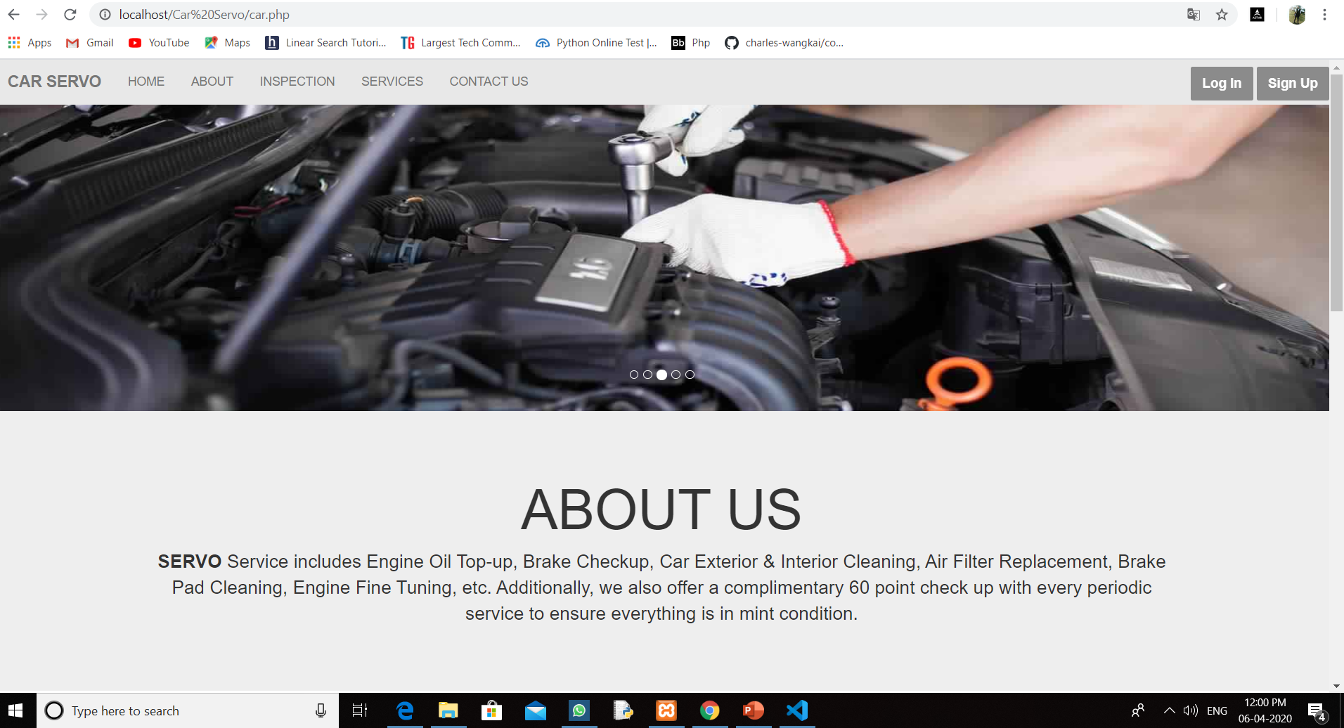
Screenshots

Slide 19
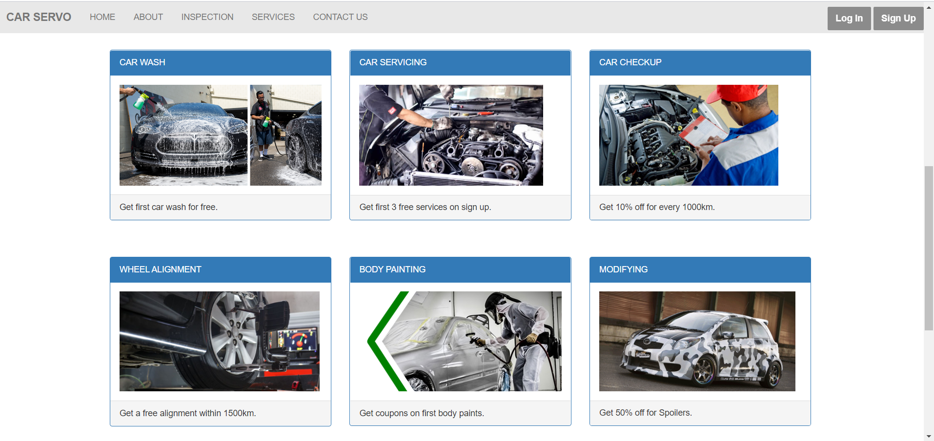
Main Page

Slide 20
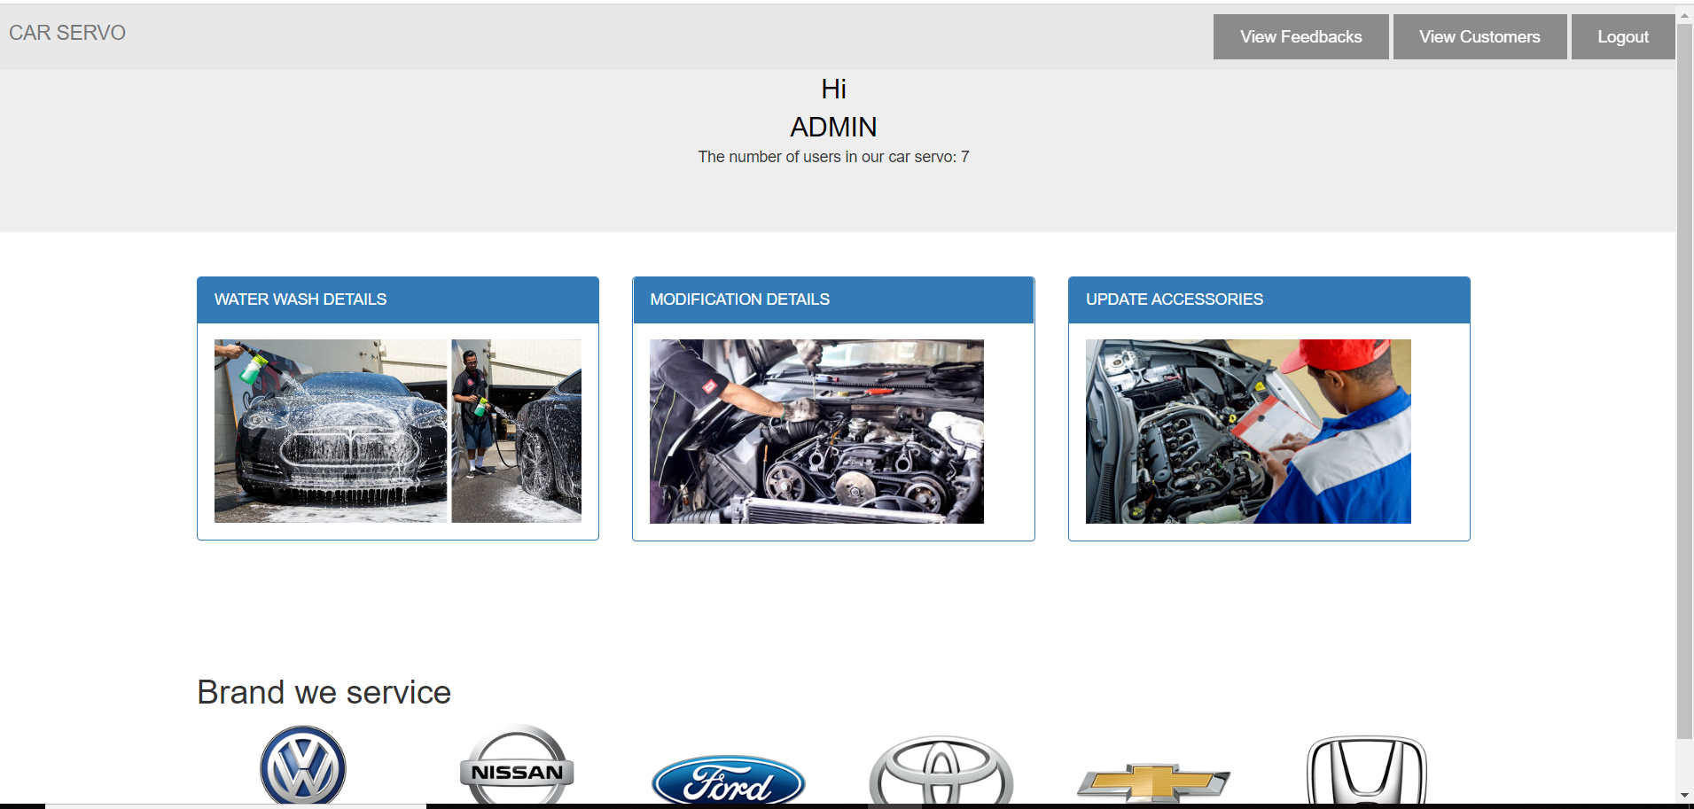
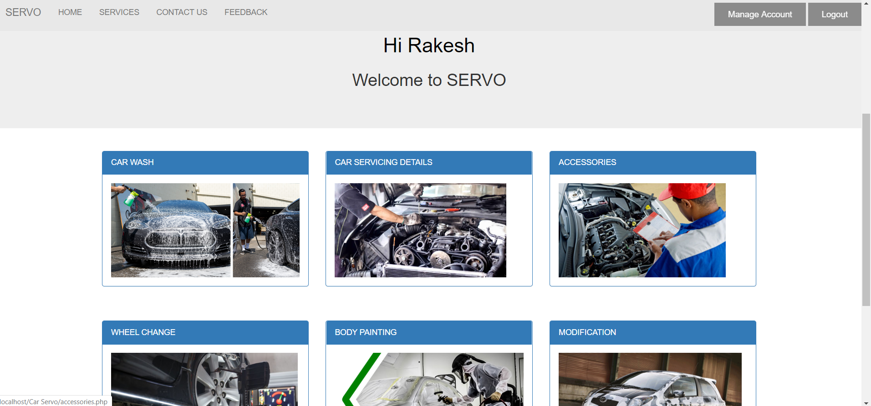
Login Pages

Slide 21
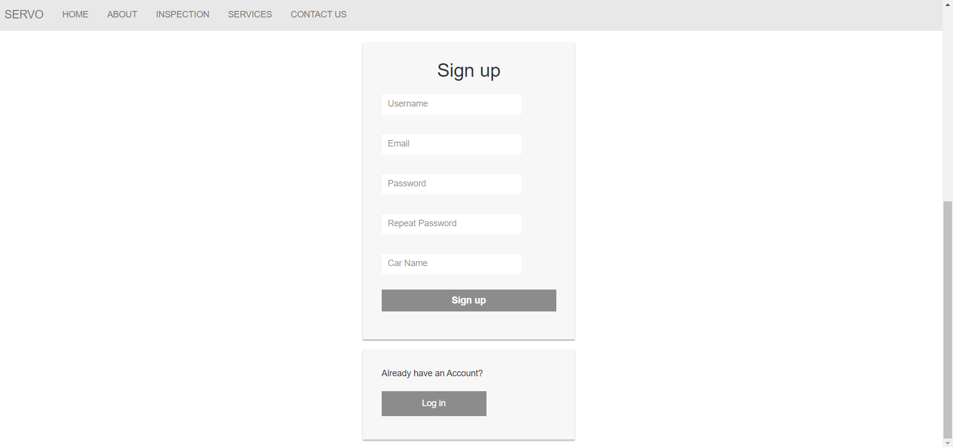
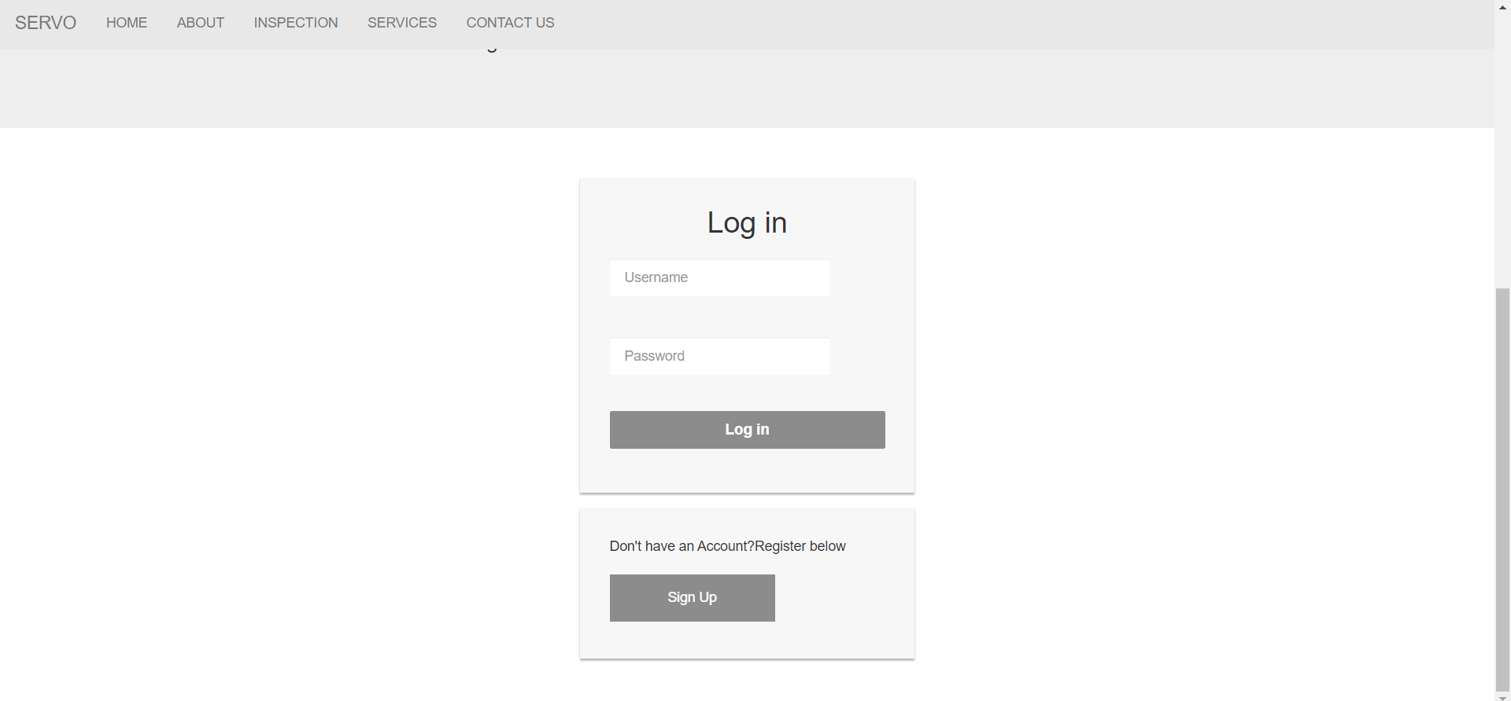
Options for Account

Slide 22
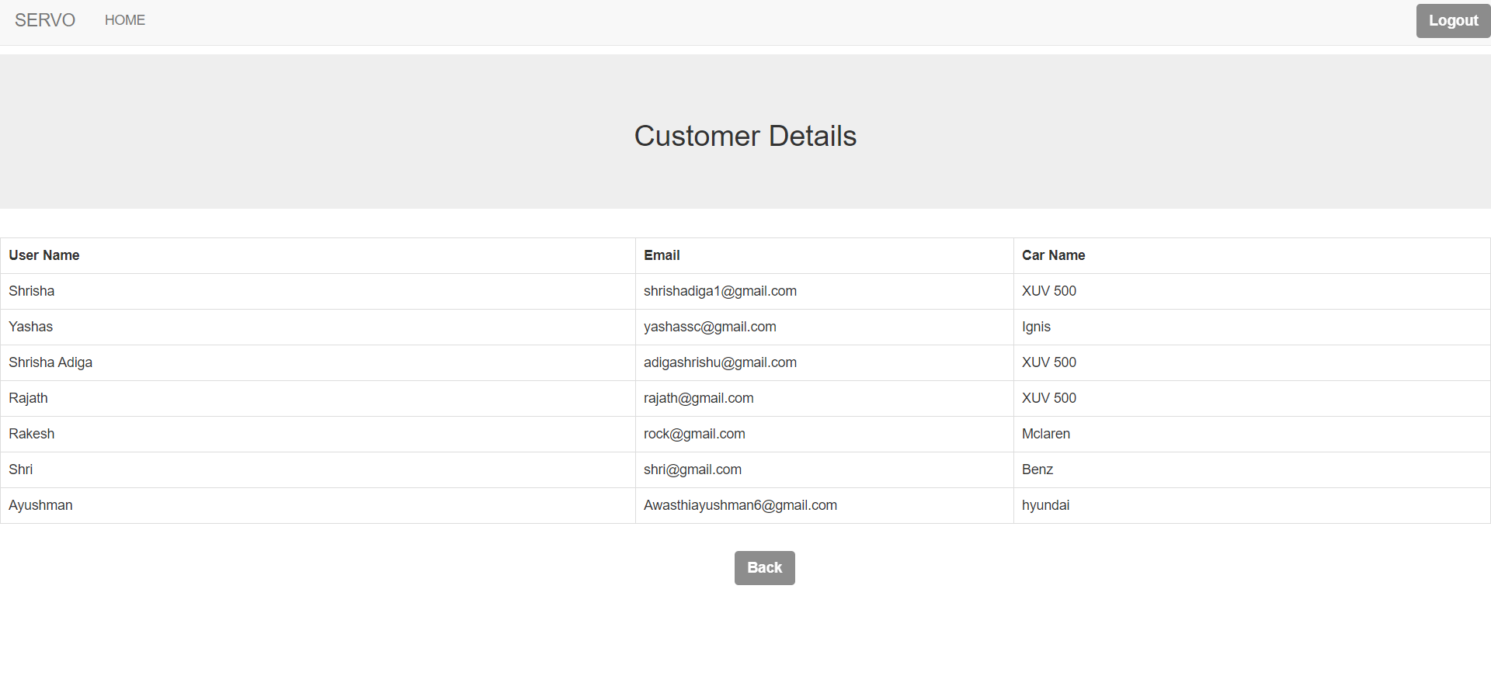
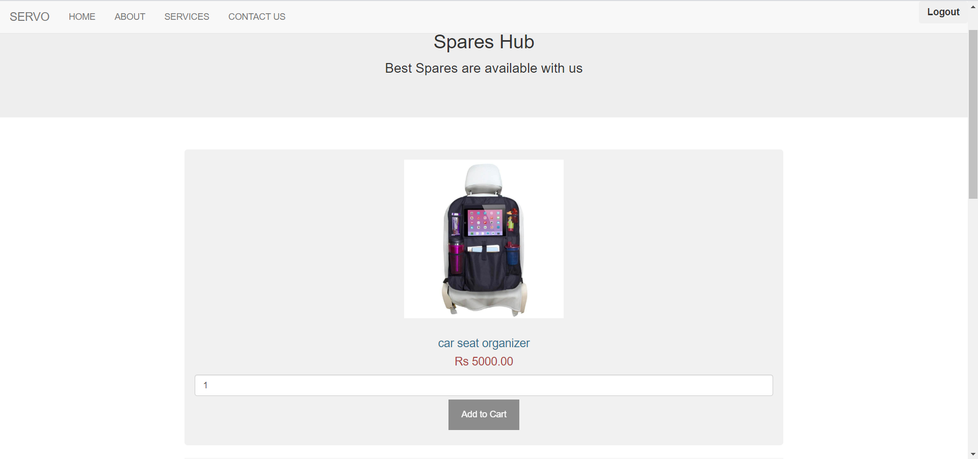
Other details

Slide 23
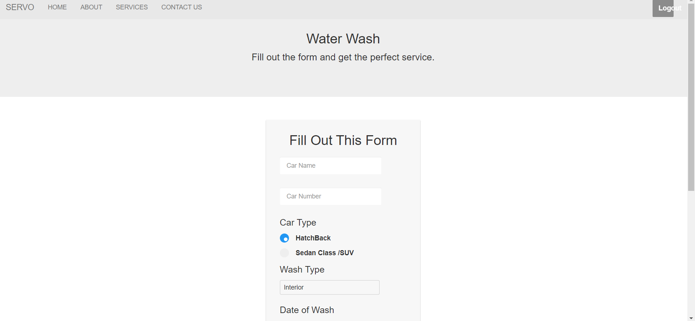
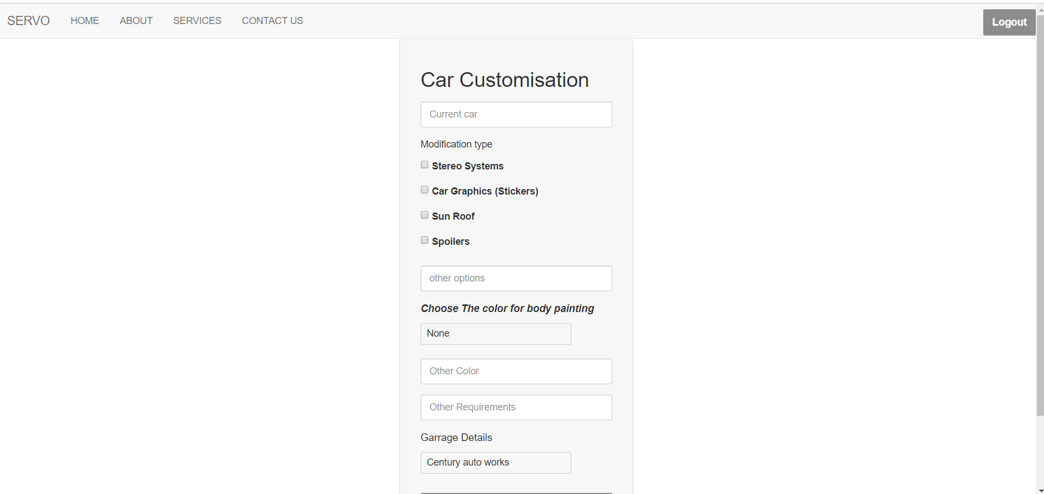
Other Details

Slide 24
Future Scope
Chatbot with complete functionality.
More options and properties can be added.
Face Detector auto login.

Slide 25
BIBLIOGRAPHY AND REFERENCES
WEBSITES :
https://www.geeksforgeeks.org
www.infomatics.info
https://www.w3schools.com//

